Slide 1
Affordable connectivity program (ACP)
December 8, 2022
Britte D. Earp, Infrastructure Implementation Coordinator, PA DCED

Slide 2
Affordable connectivity PROGRAM
Up to $30 per month off internet costs
Up to $100 off a device such as tablet or laptop for some participating providers
Limited to one monthly service discount and one device discount per household.

Slide 3
Affordable connectivity PROGRAM
ELIGIBLE HOUSEHOLDS:
Income at or below 200% of federal poverty guidelines
OR
Participation in several federal assistance programs including Medicaid, SSI, WIC, Veterans Pension and Lifeline
OR
Meets eligibility criteria for reduced cost internet program with participating internet service providers.

Slide 4
Affordable connectivity PROGRAM
Two step enrollment process:
Apply via AffordableConnectivity.gov or print out a mail-in application from that site.
Contact the preferred participating provider to select a service plan and have the discount applied to the monthly bill.
Some providers may have an alternative application they will ask to be completed.
Eligible households must complete both steps to be enrolled and benefit from the program.

Slide 5
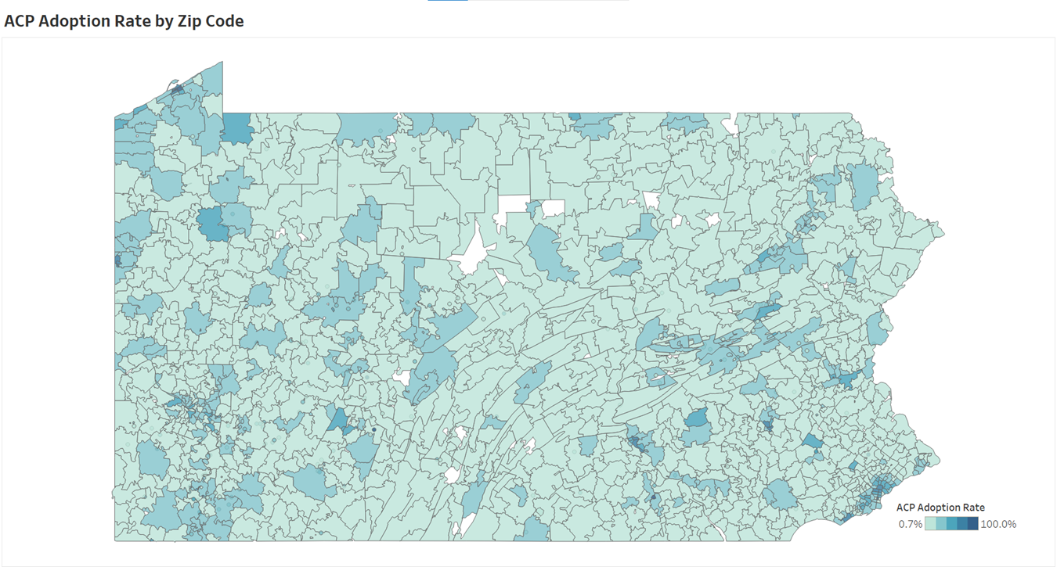
Affordable connectivity program

Slide 6
Affordable connectivity program
Outreach Opportunities:
Generate more awareness about the program
Ensure more eligible individuals apply

Slide 7
Affordable connectivity PROGRAM
ACP Outreach Grant: to promote ACP and increase awareness of and participation in the ACP among eligible households.
Eligible Applicants are state governments, local governments, public housing agencies, social service providers, education organizations, workforce development training organizations, non-profit organizations, community-based organizations, community anchor institutions, public service organizations, consortia of eligible entities
No match requirement.
Funding awards to range from $50,000 to $1,000,000
Applications are due by January 9, 2023

Slide 8
Affordable connectivity program
Your Home, Your Internet Pilot Program (YHYI) Outreach Grant: for outreach activities (including application assistance) to increase awareness and encourage participation in the ACP for households receiving federal housing assistance.
Eligible applicants are state, local, and Tribal housing agencies (including housing authorities) or non-profit organization, community-based, organization, or tenant association partners to federal, state, local, or Tribal housing agencies (including housing authorities) entities.
YHYI funding will only be provided to entities that are selected to participate in the YHYI Pilot Program.
No match requirement.
1 year grant period.
Applications due January 9, 2023.

Slide 9
Affordable connectivity program
ACP Navigator Pilot Program (NPP) Outreach Grant: Provides funding to support outreach activities to increase awareness and encourage participation in the ACP among eligible households (including application assistance).
Eligible entities are schools and school districts, or other local or state government entities,
NPP funding will only be provided to entities that are selected to participate in the ACP Navigator Pilot Program.
1 year grant period
No match requirement.
Applications due January 9, 2023

Slide 10
Affordable connectivity program
More detailed information about the ACP Outreach grant programs can be found on the FCC site here: Affordable Connectivity Outreach Grant Program | Federal Communications Commission (fcc.gov)

Slide 11
Affordable connectivity PROGRAM
Affordable Connectivity Program - PA Department of Community & Economic Development
Any comments, input, or questions, please contact me:
Britte Earp, brearp@pa.gov
717.433.8630

Slide 12
BRITTE D. EARP INFRASTRUCTURE IMPLEMENTATION COORDINATOR PA DCED
800.379.7448

